Slide 1
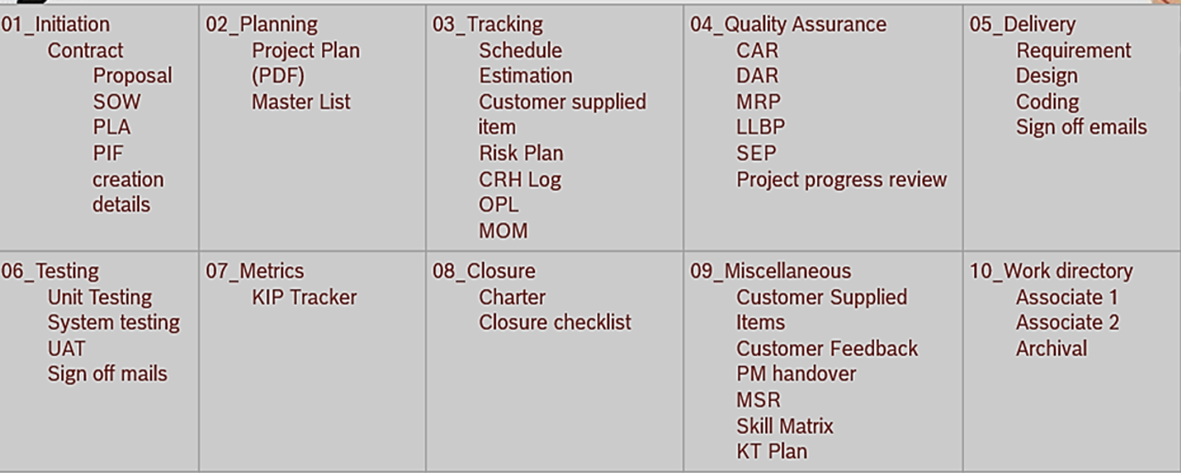
Resource Plan
Release Notes
Project Charter
Legal Communication
CCR
Configuration Audit
PQSR
SonarQube Report
Vulnerability Scan Report

